Slide 1
Exploratory Analysis and Recommendations for Efficient Customer Service
Shahrzad Khayatbashi
28th January 2025

Slide 2



Key Insights Unveiled from the Dataset
Feature Analysis
Number of Contacts
Key Features
Validation
Process Analysis
Key Findings for process improvement:
Using Chat more
Using Emails less

Slide 3
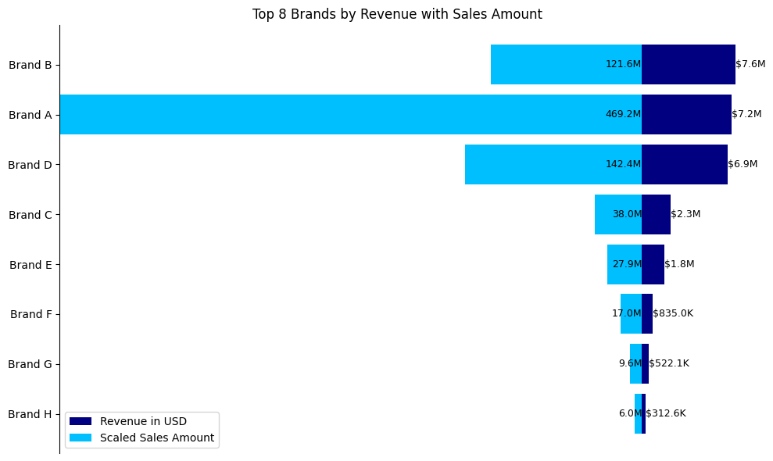
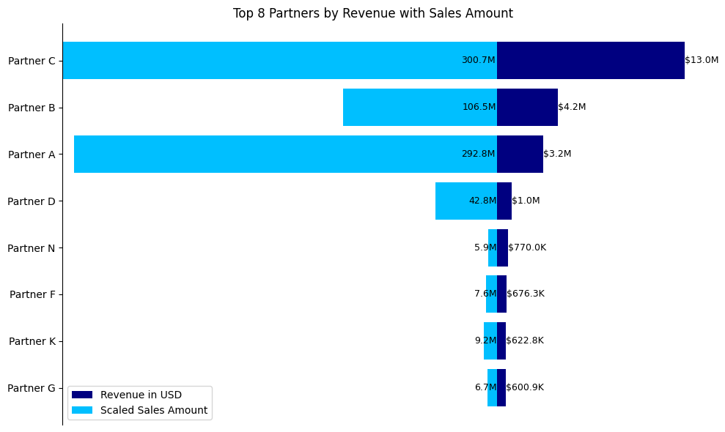
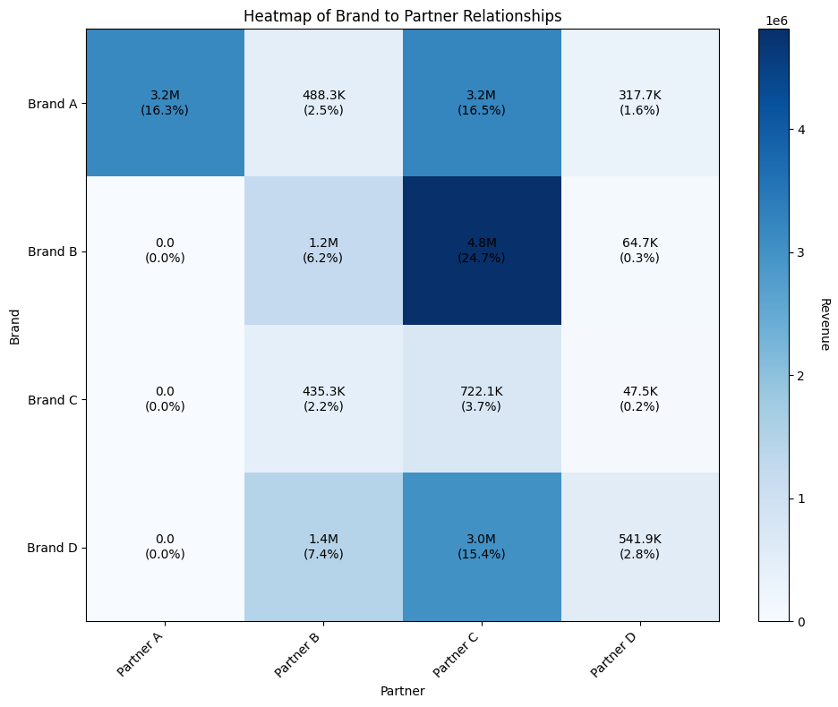
Sales Amount & Revenue Analysis by Brands (and Partners)
Feature Analysis
Number of Contacts
Key Features
Validation
Process Analysis

Slide 4
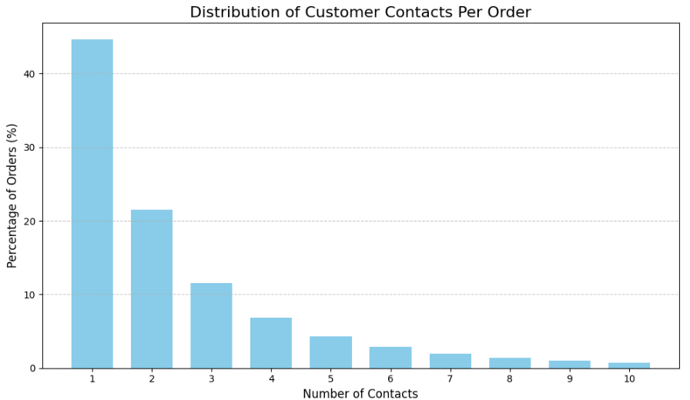
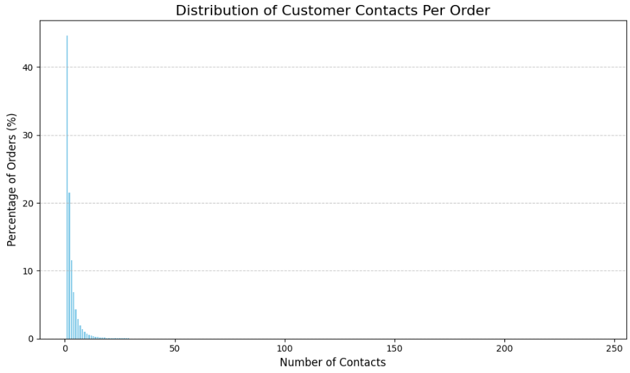

Distribution and Percentage of Contacts per Order
Feature Analysis
Number of Contacts
Key Features
Validation
Process Analysis
Key Insight: Around 45 percent of orders having contacts have one contact

Slide 5

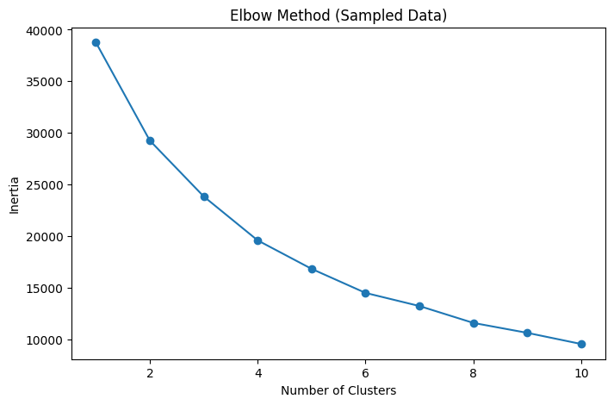

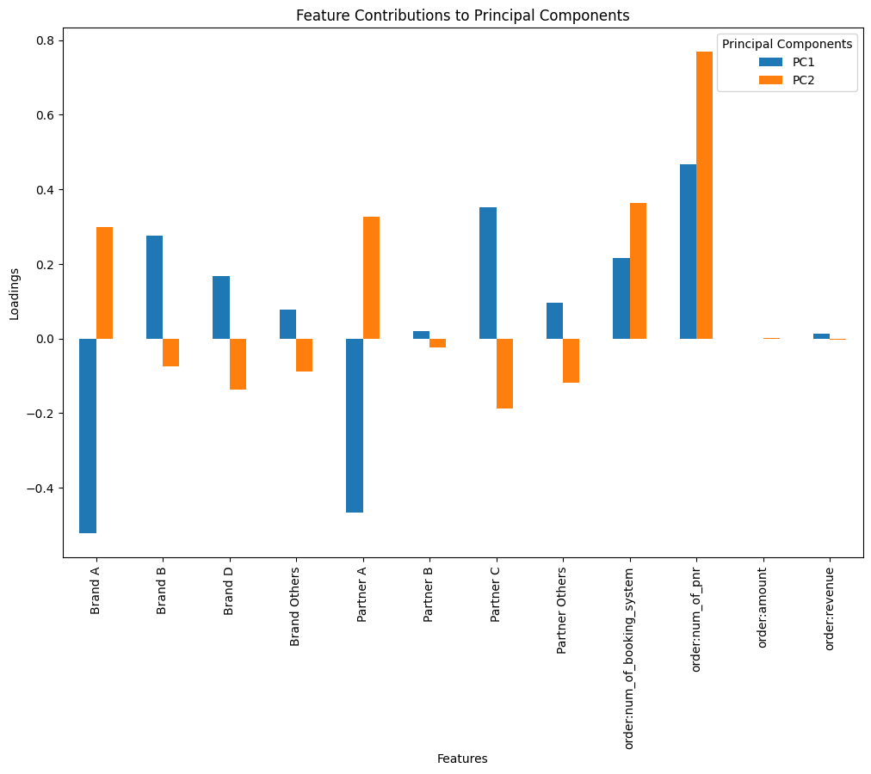

Finding Patterns and Key Insights in Data Using Clustering
Feature Analysis
Number of Contacts
Key Features
Validation
Process Analysis
Selected features:
Brand A
Brand D
Partner A
Partner C
order:num_of_booking_system
Bran B
Brand Others
Partner B
Partner Others
order:num_of_pnr
First I applied Elbow Method on Sample data of 20,000 Rows

Slide 6
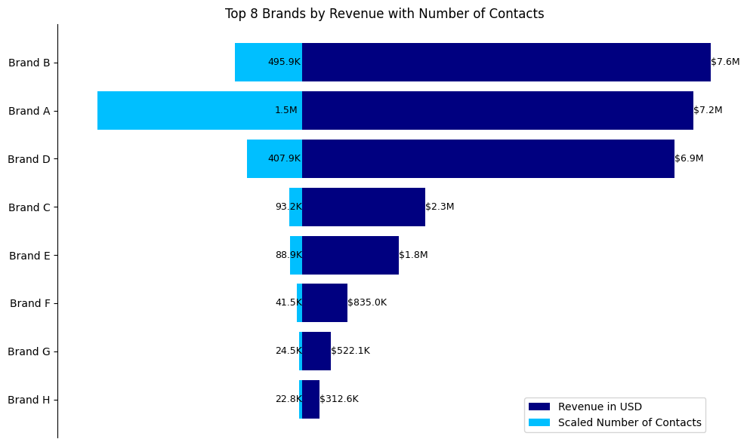
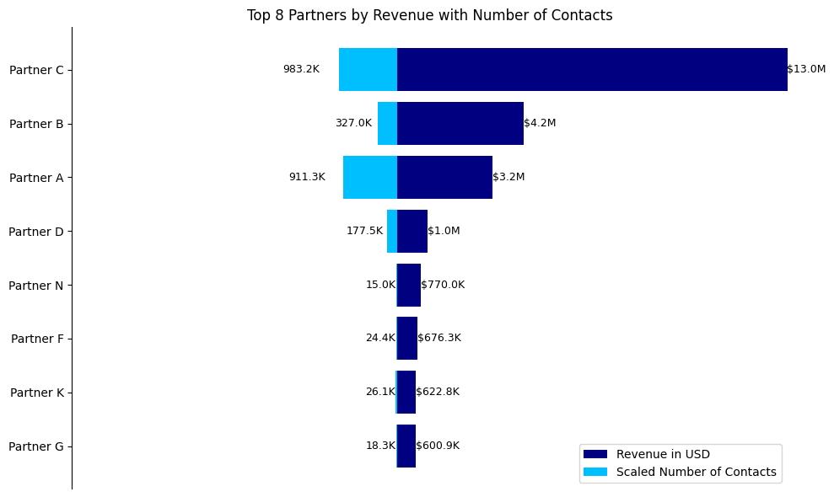
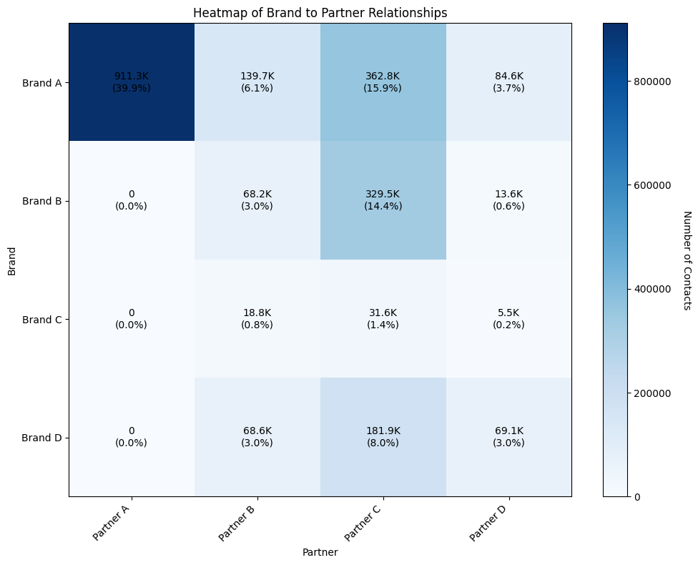
Number of Contacts & Revenue by Brands (and Partners)
Feature Analysis
Number of Contacts
Key Features
Validation
Process Analysis
6

Slide 7
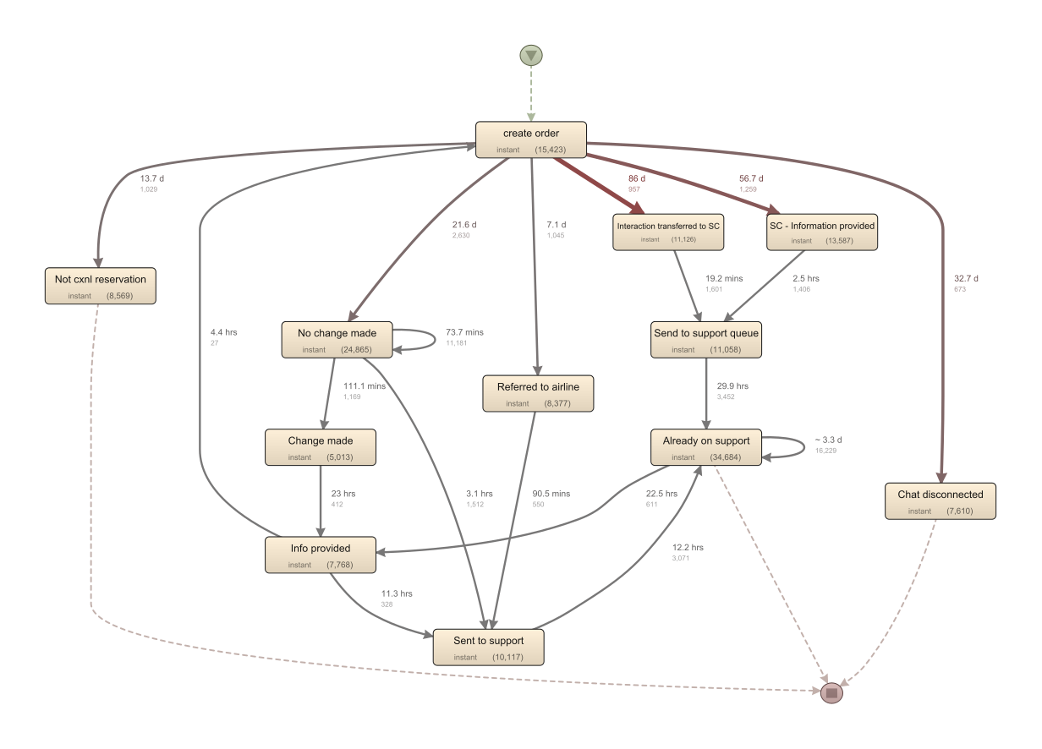
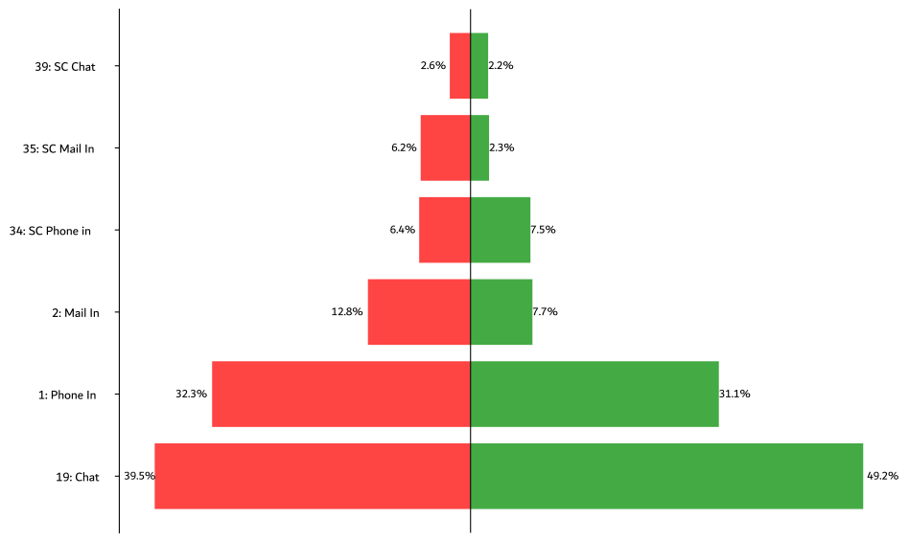
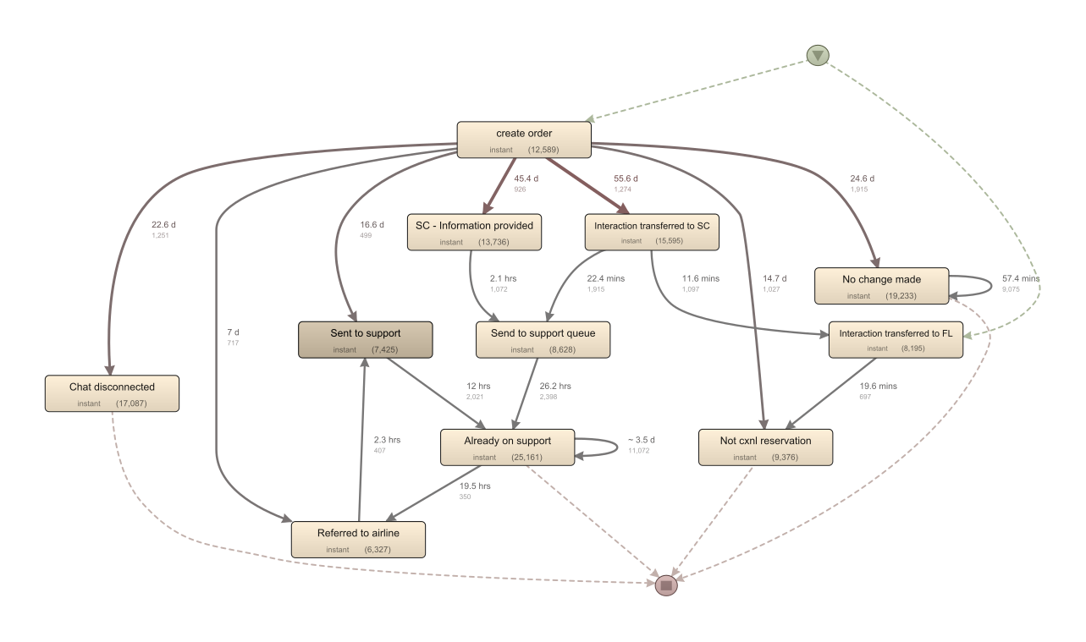

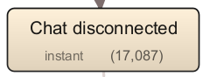
Process Analysis
Feature Analysis
Number of Contacts
Key Features
Validation
Process Analysis
BRAND:
A PARTNER: ABD
Num contact>=10
5 % Activities
BRAND:
BCD PARTNER: BCD

Slide 8

Summary and Future Directions
Feature Analysis
Number of Contacts
Key Features
Validation
Process Analysis
Opportunities for Improvement:
Using more Chats
Using less Emails
Call Transcription and Analysis
Implementing Chatbots
Threats to Validity:
Extracted Data Period
Domain Knowledge
Potential Areas for Further Investigation:
Number of Booking Systems and PNRs
Cancellations and Booking Changes

